Slide 1
Candidates for Advisory Board 2022

Slide 2
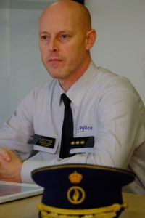
Peter Muyshondt Chief of police of the local police area Rupel, member of the Civil Society Task Force on Drugs (CSTF), representing the affected populations – families Lost his brother to heroine, cocaine and legal medication. When his brother was alive, he firmly believed that prohibition protected youngsters and improved security in society. The sudden death of his brother made him question the effects of prohibition. Since a few years he is advocating for other drug policies that better protect young people and their families. He is advocating for Anyone’s Child, a worldwide campaign from Transform Drug Policy Foundation that gives families a voice. As a member of the CSTF he wants to contribute to the better representation of civil society in the international process of policy evaluation and adjustment. Peter is also entitled to speak in the name of Law Enforcement Action Partnership, another grassroot organization, representing many active and former police officers, lawyers, prison guards, judges and prosecutors, challenging prohibition.

Slide 3
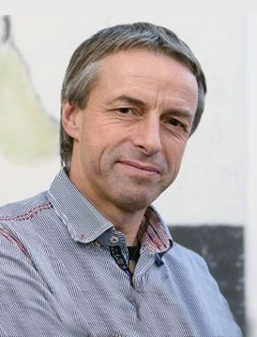
Pavel Bem Member of the Global Commission on Drug Policy. Commissioner of the Governmental Drug Commission of the Czech Republic. The former mayor of Prague and the former member of the Czech Parliament. One of the founders of the Czech drug policy based on decriminalization, harm reduction and respect to human rights. Founder of the system of low threshold drop-in centers in Czech Republic. Practicing psychiatrist, dealing with the problems of drug addicts. Long-term supported and advocate of harm reduction services.

Slide 4
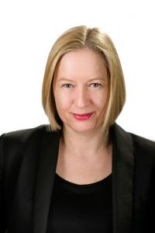
Julia Buxton British Academy Global Professor, department of Criminology, University of Manchester, UK Published expert on the drug trade, with a particular interest in the impact of counter-narcotics enforcement on women, development, public health, and human rights Senior Research Fellow at the Global Drug Policy Observatory, University of Swansea Previously Professor and Acting Dean, School of Public Policy, Central European University, Budapest; Senior Research Fellow, Department of Peace Studies, University of Bradford and Senior Lecturer, University of Kingston UK

Slide 5
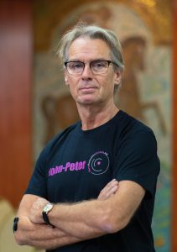
John- Peter Kools Senior adviser on Drug Policy, Trimbos Institute of Mental Health and Addiction, the Netherlands In Harm Reduction – since 1983. Since 1996 has been working in EECA projects. Researcher, scientist, transition and developing economies specialist.

Slide 6
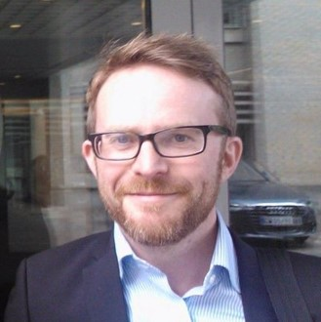
Damon Garrett, Jur. Dr. The Co-Director of the International Centre on Human Rights and Drug Policy, Sweden Damon is the co-Director of the International Centre on Human Rights and Drug Policy, which he co-founded in 2009. He is a Lecturer at the School of Public Health and Community Medicine, Sahlgrenska Academy, University of Gothenburg. From 2007-2014 he worked at Harm Reduction International, including as Deputy Director.

Slide 7
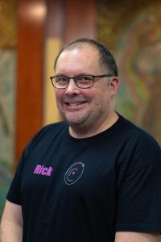
Rick Lines Associate Professor of Criminology and Human Rights, School of Law, Swansea University, UK Author of ‘Drug Control and Human Rights in International Law’ (2017); Co-founder and Chair of the International Centre on Human Rights and Drug Policy at the Human Rights Centre, University of Essex; Senior Research Associate, Global Drug Policy Observatory, Swansea University; Former Executive Director of Harm Reduction International; Past member of the Strategic Advisory Group to the United Nations on HIV and Drug Use, and the Technical Advisory Group to the Global Commission on HIV and the Law.

