Slide 1
Injecting Drug User Implementation Tool (IDUIT) Training Workshop Day Three

Slide 2
IDUIT Training Workshop / Day Three / Session 12
Plan for the day
Preparation for policy dialogue
Assessment, feedback and closure
Policy Dialogue meeting:
Welcome, introductions and overview of the IDUIT
Overview of local policy context
Overview of existing HIV and HCV programmes for people who inject drugs
Facilitated dialogue: enhancing programmes and policy
The way forward
Closing

Slide 3
IDUIT Training Workshop / Day Three / Session 13
Preparing for a dialogue with policy makers
Developing Content
What are you asking the policy maker?
Preparing to address common challenges and questions

Slide 4
IDUIT Training Workshop / Day Three / Session 13
Tips: Effective presentations
Have focused key messages
Pick no more than three priorities, plus back-ups
Include background information to meet the audience’s needs
If you are in the planning stage, present some idea of where your work will lead
Highlight why your work is important for policy
Sum this up in a few sentences – for yourself and for others
Discuss facts/data and stories/anecdotes for each priority
Identify potential state- or district-specific, real-life implications of policies that are currently being discussed
Think through clearly and carefully why your message is important
Make your requests explicit
Make sure you know what exactly you want them to do

Slide 5
IDUIT Training Workshop / Day Three / Session 13
Tips: Effective engagement
Write down the questions you want to ask the policy maker
Brainstorm responses to questions you may get
Discuss ways to follow up after meetings
Be friendly and adopt a positive attitude towards policy makers
Find out what they want
Present solid evidence and get it right (be prepared)
Speak clearly and concisely – avoid jargon and arguing
Present factual, non-emotive responses if you disagree on a point (avoid negative reactions)
Make your comments personal and provide local context
Take materials to leave with policy makers
Be sure to thank everyone
If a policy maker requests information, respond within a week
Cultivate relationships

Slide 6
IDUIT Training Workshop / Day Three / Session 13
Activity: Preparing for dialogue with policy makers
Participants to divide into four groups to develop ’talking points’ related to priorities chosen which can be used in the policy dialogue (or in future advocacy work)

Slide 7
IDUIT Training Workshop / Day Three / Session 13
Priorities for discussion
Legal reform
Human rights
Services
Community empowerment

Slide 8
IDUIT Training Workshop / Day Three / Session 13
Activity: Presentations and Feedback

Slide 9
IDUIT Training Workshop / Day Three / Session 14
Assessment Feedback and Closure

Slide 10
IDUIT Training Workshop / Day Three / Session 15
Dialogue with Policy Makers

Slide 11
IDUIT Training Workshop / Day Three / Session 15
Dialogue objectives
To highlight commitments to prevent and treat HIV and HCV among people who inject drugs
To introduce policy makers, service providers and others to the IDUIT
To share knowledge and engage around increased support for and provision of recommended HIV and HCV services with people who inject drugs
To provide a networking opportunity
To highlight the critical role that people who inject drugs play in the implementation of effective HIV programmes aimed at them

Slide 12
IDUIT Training Workshop / Day Three / Session 15
Agenda
Welcome, introductions and overview of the IDUIT
Overview of local policy context
Overview of existing HIV and HCV programmes for people who inject drugs
Facilitated dialogue: enhancing programmes and policy
The way forward
Closing

Slide 13
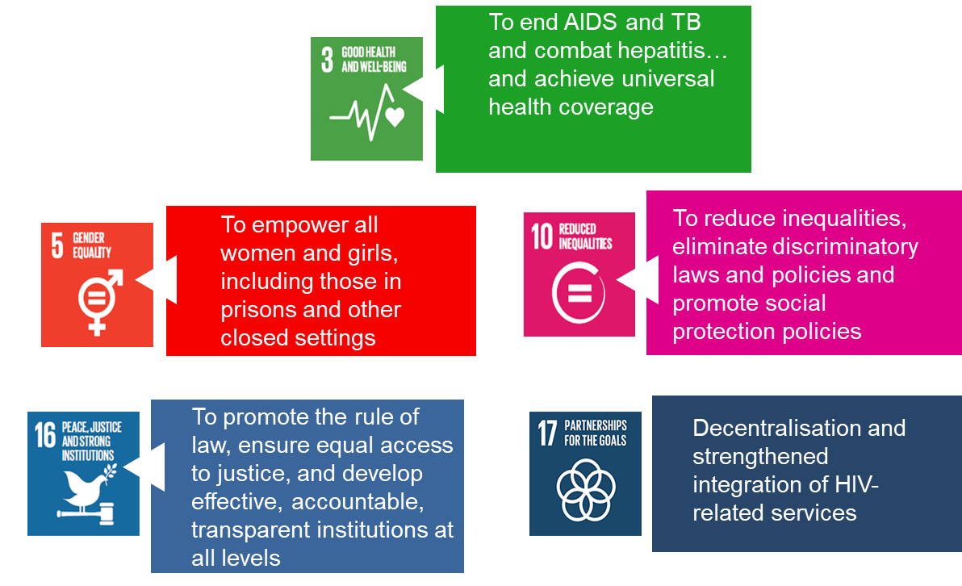
IDUIT Training Workshop / Day Three / Session 15
2030 Agenda for Sustainable Development

Slide 14
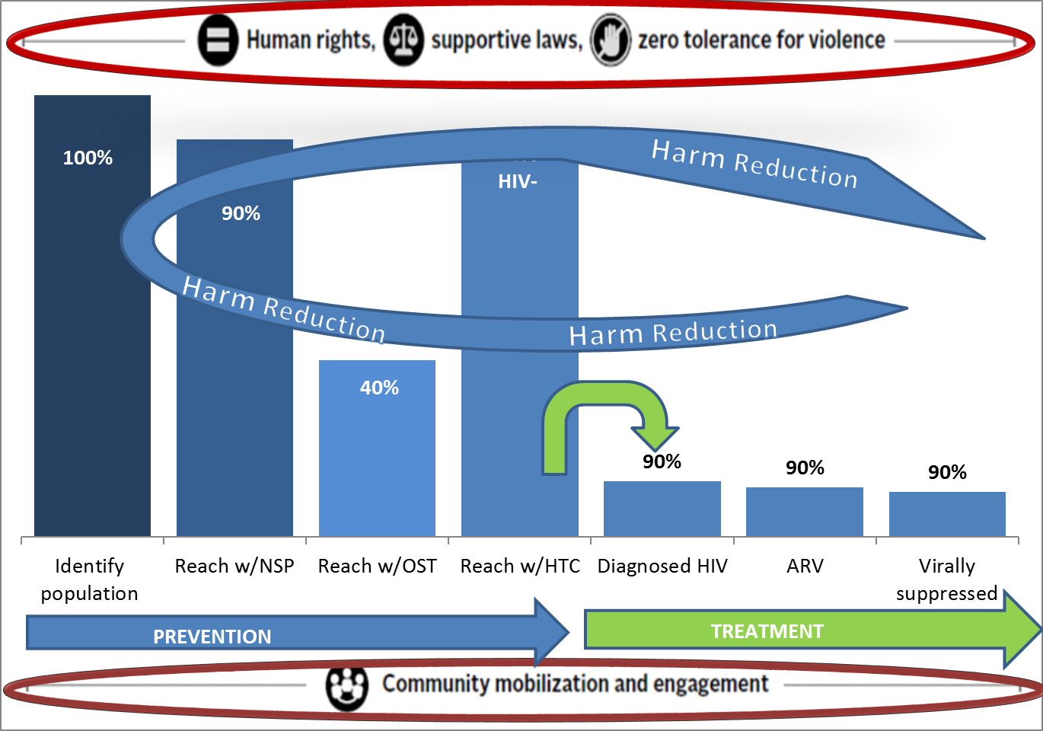
IDUIT Training Workshop / Day Three / Session 15
Fast-track Strategy for Ending AIDS among People who Inject Drugs
UNAIDS has a fast-track strategy that shows the percentage of PWID who should have access to specific services by 2021.
It emphasises that to achieve this countries must address:
Human rights
Supportive laws
Zero tolerance for violence
Community mobilisation and engagement

Slide 15
IDUIT Training Workshop / Day Three / Session 15
UNGASS 2016 Outcome Documents
“We reiterate our commitment to end by 2030 the epidemics of AIDS and tuberculosis, as well as combat viral hepatitis, other communicable diseases, inter alia, among people who use drugs, including people who inject drugs” [In line with SDG target 3.3]

Slide 16
IDUIT Training Workshop / Day Three / Session 15
UNGASS 2016 Outcome Document
Chapter 1:
Treatment of drug use disorders, rehabilitation, recovery and social reintegration; prevention, treatment and care of HIV/AIDS, viral hepatitis and other bloodborne infectious diseases
Chapter 2:
Ensuring the availability of and access to controlled substances exclusively for medical and scientific purposes, while preventing their diversion
Chapter 3:
Cross-cutting issues: drugs and human rights, youth, children, women and communities

Slide 17
IDUIT Training Workshop / Day Three / Session 15
Realising SDG Target 3.3 & UNGASS 2016 Commitments
Missed 50%
Reduction target
(UNGASS)

Slide 18
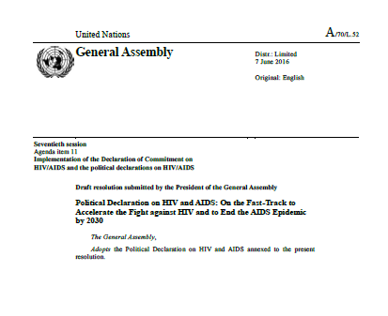
IDUIT Training Workshop / Day Three / Session 15
2016 High-Level Political Declaration on Ending AIDS
Commits to building people centered systems for health by strengthening health and social systems, including for populations that epidemiological evidence shows are at higher risk of infection, and by expanding community-led service delivery to cover at least 30% of all service delivery by 2030

Slide 19
IDUIT Training Workshop / Day Three / Session 15
Effective HIV services for people who inject drugs WHO/UNODC/UNAIDS comprehensive package of interventions:
Needle and syringe programmes (NSPs)
Opioid substitution therapy (OST) and other evidence-based drug dependence treatment
HIV testing and counselling (HTC)
Antiretroviral therapy (ART)
Prevention and treatment of sexually transmitted infections (STIs)
Condom programmes for people who inject drugs and their sexual partners
Targeted information, education and communication (IEC) for people who inject drugs and their sexual partners
Prevention, vaccination, diagnosis and treatment for viral hepatitis
Prevention, diagnosis and treatment of tuberculosis (TB)
10. Opioid overdose prevention and management

Slide 20
IDUIT Training Workshop / Day Three / Session 15
Availability of OST and NSPs (2016)
In 158 countries where injecting drug use has been documented:
90 (57%) countries are implementing NSPs
80 (51%) countries have ≥ 1 OST programme

Slide 21
IDUIT Training Workshop / Day Three / Session 15
Coverage of harm reduction

Slide 22
IDUIT Training Workshop / Day Three / Session 15
Implementation Toolkits have been effective in increasing coverage of
rights-affirming, evidence-based responses to HIV and STI’s

Slide 23
IDUIT Training Workshop / Day Three / Session 15

Slide 24
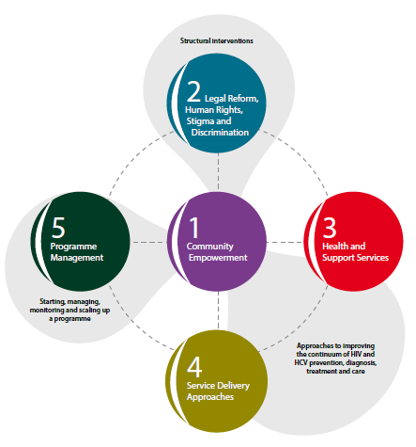
IDUIT Training Workshop / Day Three / Session 15
Overview
Guidance on how to implement
Target audience: health officials, managers of HIV and harm reduction programmes, civil society organisations, health workers
5 chapters each chapter includes:
Description of focal areas
Practical guidance
Case studies
Resource list

Slide 25
IDUIT Training Workshop / Day Three / Session 15
Consultation and policy dialogue/advocacy with national bodies
on human rights, health and entitlements
Domestic investment
Supportive legal & policy environments
Resource mobilisation
Economic empowerment
Violence prevention
& response
Social & legal protection
Service delivery
Community drop-in/social centre:
embedded health/social services
Research, evidence generation
Community organisation (network/collective)
Recording & reporting
Comprehensive, integrated service package
Community mobilisation/capacity building
Community-based/mobile services & outreach
Public health/ social services
Grassroots

Slide 26
IDUIT Training Workshop / Day Three / Session 16
Local policy context

Slide 27
IDUIT Training Workshop / Day Three / Session 17
HIV and HCV programmes
for people who inject
drugs

Slide 28
IDUIT Training Workshop / Day Three / Session 18
Discussion

Slide 29
IDUIT Training Workshop / Day Three / Session 19
The way forward

Slide 30
IDUIT Training Workshop / Day Three / Session 19
The way forward
Policy level
Capacity building
Financing
Address structural barriers
Other priorities raised

Slide 31
IDUIT Training Workshop / Day Three / Session 20
Closing and thanks

