Slide 1
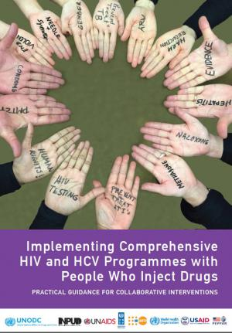
Injecting Drug User Implementation Tool (IDUIT) Training Workshop Day One

Slide 2
IDUIT Training Workshop / Day One / Session 1
WELCOME
The purpose of this session:
To facilitate networking between participants
To understand participants’ expectations
To inform participants about the work- shop structure and objectives

Slide 3
IDUIT Training Workshop / Day One / Session 2
Synopsis
Globally, people who inject drugs (PWID) are have higher rates of HIV and hepatitis C virus (HCV) than the general population.
Criminalisation and stigmatisation of people who use drugs (PWUD) limits their access to effective programmes, like needle and syringe programmes, opioid substitution therapy and treatment for HIV and HCV infection.
This workshop is based on global guidance on how to implement the World Health Organization, UNODC and UNAIDS comprehensive package of HIV services for people who inject drugs based on the IDUIT.
People who use drugs have an essential role in advocating for and planning, implementing and evaluating effective programmes.

Slide 4
IDUIT Training Workshop / Day One / Session 2
Ground rules
Timekeeping
Mobile phones and lap tops
Respect for each other
Allow time for each person to speak
These may vary for each workshop

Slide 5
IDUIT Training Workshop / Day One / Session 2
Activity: Introductions and expectations
Participants to get to know one another and understand their expectations of the workshop

Slide 6
IDUIT Training Workshop / Day One / Session 2
Workshop objectives
Part 1: For community members
Raise awareness of the Implementing Comprehensive HIV and HCV Programmes with People who Inject Drugs: practical guidance for collaborative interventions (IDUIT)
Build knowledge of evidence-based comprehensive HIV and viral hepatitis C programmes for PWID
Build community capacity to use the IDUIT guide for programme planning, implementation & advocacy
Prepare community members for dialogue with policy makers so that they can highlight:
Achievements
Advocacy priorities
How they can contribute to working on advocacy priorities
Part 2: For service providers, community members and policy makers
Highlight the critical role that people who inject drugs play in the implementation of effective HIV programmes for people who inject drugs

Slide 7
IDUIT Training Workshop / Day One / Session 2
Agenda
DAY 1
Community empowerment
Legal reform, rights, stigma and discrimination
DAY 2
Introduction to the IDUIT guide
Health and social services, delivery and management
Community involvement and leadership in services
DAY 3
Preparation for policy dialogue
Dialogue with policy makers around HIV & HCV services with people who inject drugs

Slide 8
IDUIT Training Workshop / Day One / Session 2
Assessment (OPTIONAL)
To assess participants’ knowledge of issues of relevance to HIV and HCV in the context of injecting drug use

Slide 9
IDUIT Training Workshop / Day One / Session 3
Background & rationale
Governments of countries throughout the world have signed a number of inter- national agreements that express their commitment to protect the health
and rights of people, including specifically people who use drugs

Slide 10
UN 2030 Agenda for Sustainable Development
IDUIT Training Workshop / Day One / Session 3
10
Countries have committed to making key changes by 2030 including for people who use drugs
UN member states, including this country, agreed on goals to be achieved by 2030
To achieve theses goals, changes are needed to:
Protect the rights of people who use drugs
Ensure their access to prevention, treatment and social services
To end AIDS and TB and combat hepatitis… and achieve universal health coverage
To empower all women and girls, including those in prisons and other closed settings
To reduce inequalities, eliminate discriminatory laws and policies and promote social protection policies
To promote the rule of law, ensure equal access to justice, and develop effective, accountable, transparent institutions at all levels
Decentralisation and strengthened integration of HIV-related services
Notes:
In September 2015, member states adopted 2030 Agenda for Sustainable Development.
http://www.un.org/ga/search/view_doc.asp?symbol=A/RES/70/1&Lang=E
It comprises of 17 sustainable development goals
Including goal 3.3 to end the AIDS epidemic by 2030
Other goals contribute also to the HIV response among PWID

Slide 11
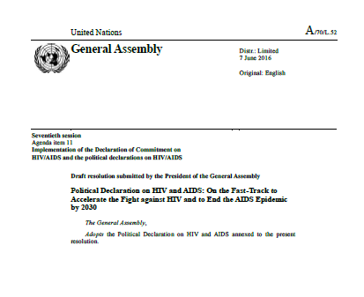
IDUIT Training Workshop / Day One / Session 3
Countries committed to expand access to services, including community-led services, in the 2016 High-Level Political Declaration on Ending AIDS
“Commit to build people-centred systems for health by strengthening health and social systems, including for populations that epidemiological evidence shows are at higher risk of infection and by expanding community-led service delivery to cover at least 30% of all service delivery by 2030”

Slide 12
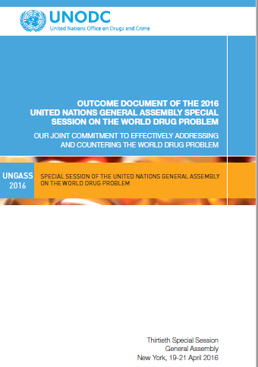
IDUIT Training Workshop / Day One / Session 3
The Outcome Document of the UNGASS on the World Drug Problem:
Builds on international conventions that:
Protect the rights of all people
Do not mandate the criminalisation of drug use
Expresses commitment to improve health of people who use drugs
“We reiterate our commitment to end by 2030 the epidemics of AIDS and tuberculosis, as well as combat viral hepatitis, other communicable diseases, inter alia, among people who use drugs, including people who inject drugs” [In line with SDG target 3.3]

Slide 13
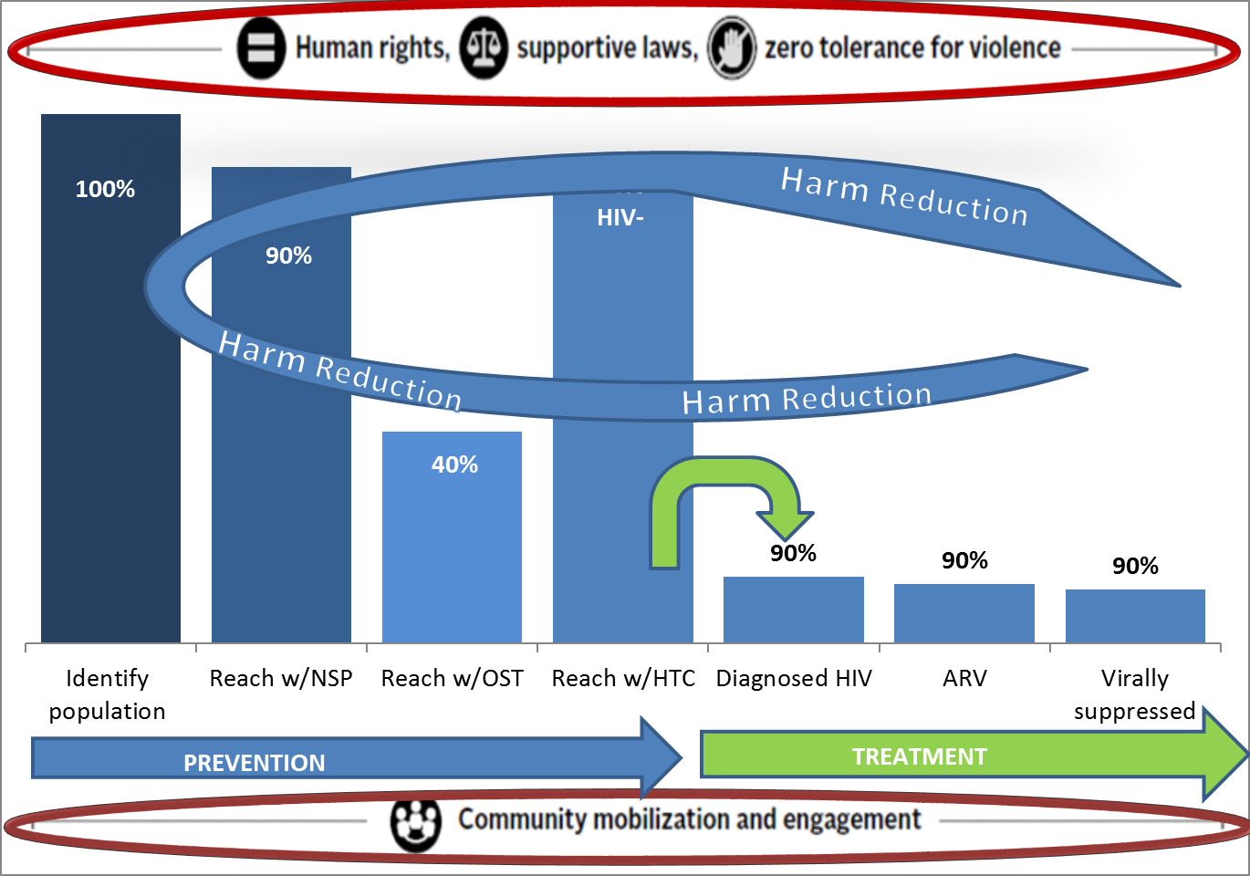
IDUIT Training Workshop / Day One / Session 3
Fast-track Strategy for ending AIDS among People who Inject Drugs
UNAIDS has a fast-track strategy that shows the percentage of PWID who should have access to specific services by 2021
It emphasises that, to achieve this, countries must address:
Human rights
Supportive laws
Zero tolerance for violence
Community mobilisation and engagement

Slide 14
IDUIT Training Workshop / Day One / Session 3
UN Guidelines recommend specific interventions for people who use drugs (1)
The WHO guidelines address:
HIV prevention, diagnosis, treatment and care
Reform of laws, policies and practices
Stigma and discrimination
Enhanced community empowerment
UNAIDS have recommended that 6% of global funding be allocated to work on these issues.

Slide 15
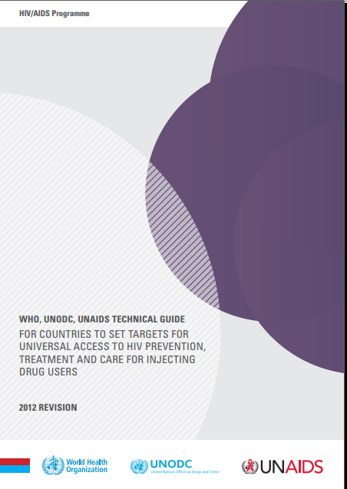
IDUIT Training Workshop / Day One / Session 3
UN Guidelines based on scientific evidence recommend specific interventions for people who use drugs (2)
WHO, UNODC and UNAIDS list a comprehensive package of interventions:
Needle and syringe programmes (NSPs)
Opioid substitution therapy (OST) and other evidence-based
drug dependence treatment
3. HIV testing and counselling (HTC)
4. Antiretroviral therapy (ART)
5. Prevention and treatment of sexually transmitted infections (STIs)
6. Condom programmes for people who inject drugs and their
sexual partners
Targeted information, education and communication (IEC) for
people who inject drugs and their sexual partners
8. Prevention, vaccination, diagnosis and treatment for viral hepatitis
Prevention, diagnosis and treatment of tuberculosis (TB)
Opioid overdose prevention and management

Slide 16
IDUIT Training Workshop / Day One / Session 3
People who use drugs have identified their values and demands
The International Network of People who Use Drugs
The Vancouver Declaration (2006)
International Network of People Who Use Drugs (INPUD) Declaration of Rights and Demands (2015
www.inpud.net/consensus_statement_2015.pdf

Slide 17
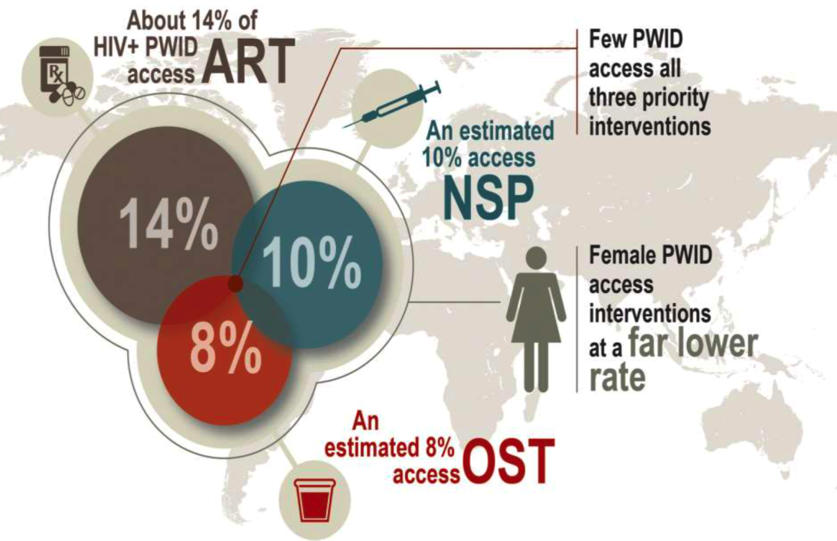
IDUIT Training Workshop / Day One / Session 3
In spite of the promises and recommendations
Only 10% have access to NSPs
Only 8% have access to OST
Only 14% have access to ART
PWUD are still criminalised
PWUD still face stigma and
discrimination
PWUD are often not adequately
mobilised to engage in policy dialogue
and in providing services

Slide 18
IDUIT Training Workshop / Day One / Session 3
Implementing Comprehensive HIV and HCV Programmes with People Who Inject Drugs: Practical Guidance for Collaborative Interventions (IDUIT)
Contains practical advice on implementing HIV and hepatitis C (HCV) programmes.
The advice is aligned with:
UN guidance
Declarations of people who use drugs
IDUIT addresses:
Key services
‘Critical enablers’, including:
Law and policy reform
Addressing violence
Community empowerment
You can use the IDUIT to see how programming in your country measures up to international standards and to promote better policy
and practice

Slide 19
IDUIT Training Workshop / Day One / Session 3
Implementation Toolkits were developed for MSM, sex workers and transgender people too

Slide 20
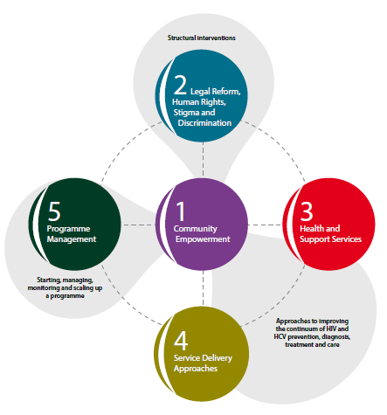
IDUIT Training Workshop / Day One / Session 3
Overview
Guidance on how to implement programmes for PWID
Targeting health officials, managers of HIV and harm reduction programmes, civil society organisations, health workers
Each 5 chapters include:
-Description of focal areas
-Practical guidance
-Case studies
-Resource list

Slide 21
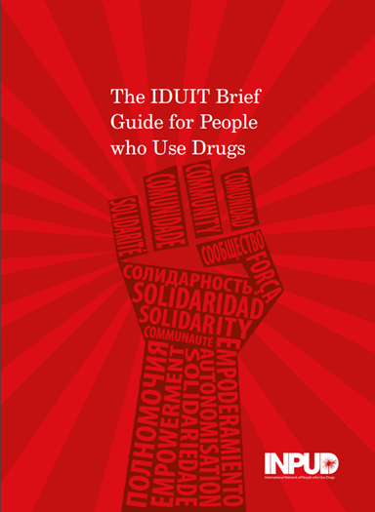
IDUIT Training Workshop / Day One / Session 3
IDUIT Brief Guide
Highlights key points in the IDUIT.
Written for people or organisations of people who inject drugs
Contains checklists to help you check whether service provision and advocacy work are carried out in line with evidence-informed UN recommendations and known preferences of people who use drugs
Some content in this brief guide is not addressed in the IDUIT but is informed by User-activists’ Views on Best Practice in Harm Reduction, which gives an overview of the opinions and preferences of experts and activists from among the community of people who use drugs.

Slide 22
IDUIT Training Workshop / Day One / Session 3
Guiding principles for HIV and HCV programmes for PWID as per the IDUIT
Human rights
Community empowerment
Community participation and leadership
Acceptability of services
Access to justice
Access to quality healthcare
Health literacy
Integrated service provision

Slide 23
IDUIT Training Workshop / Day One / Session 3
Using the IDUIT and Brief Guide
The tools can help you learn about state-of-the-art policy and practice to ensure the health and rights of people who use drugs. Knowledge is power!
You can check whether programmes for people who use drugs in your country or city is living up to international standards. The checklists in the Brief Guide will be especially helpful for this
You can use the IDUIT and Brief Guide to show your government officials, service managers and police the international standards they should be living up to

Slide 24
IDUIT Training Workshop / Day One / Session 4
Community Empowerment

Slide 25
IDUIT Training Workshop / Day One / Session 4
Understanding Community
What is community?
What is community empowerment?
What are the differences between a community-based organisation and a community-led organisation?

Slide 26
IDUIT Training Workshop / Day One / Session 4
Community-led organisations vs. Community-based organisations
Community-led organisations are not the same as community-based organisations
In community-led organisations, decision making is in the hands of people who use drugs
It is the self-governing nature of an organisation, and its commitment to pursue the goals of its members, that makes it a genuinely community-led organisation

Slide 27
IDUIT Training Workshop / Day One / Session 4
Activity – Case Studies around Community Involvement
What does community empowerment mean to you?
What top five things do you feel are essential to empower communities?
What do you think makes this case study remarkable?
What challenges do you think such a project would face in your context?
What do you think could facilitate such a project to succeed in your context?

Slide 28
IDUIT Training Workshop / Day One / Session 4
The IDUIT Definition of Community Empowerment
Is a process whereby groups of people increase control over their lives:
More than involvement, participation or engagement
Implies community ownership, and action that explicitly aims at social and political change
Addresses social, cultural, political and economic factors that affect health
Seeks to build partnerships with other sectors in finding solutions

Slide 29
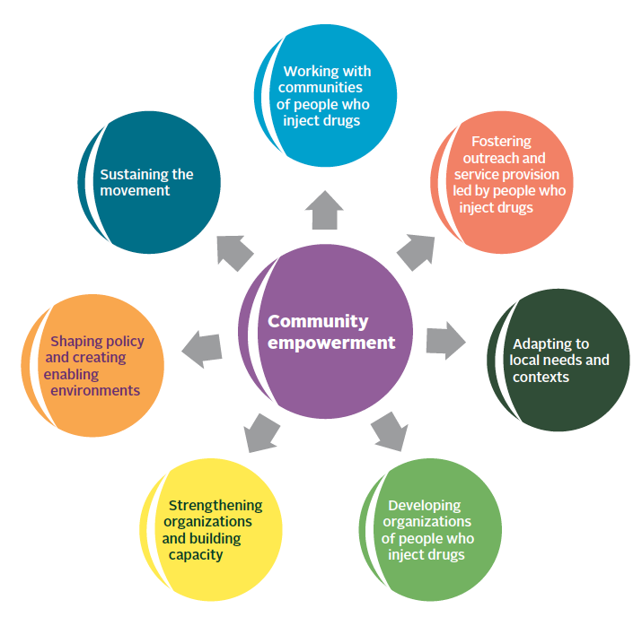
IDUIT Training Workshop / Day One / Session 4
Key Elements of Community Empowerment

Slide 30
IDUIT Training Workshop / Day One / Session 4
Meaningful Involvement (1)
International guidelines recommend that people who use drugs (PWUD) be involved in all aspects of programming
PWUD should be represented on decision-making bodies
PWUD should select their own representatives
PWUD should be given opportunities to learn about international and important issues in their countries

Slide 31
IDUIT Training Workshop / Day One / Session 4
Meaningful Involvement (2)
PWUD should be enabled to identify advocacy priorities and strategies to promote them.
People representing the PWUD community should be accountable to the people they represent
It is important to have a national network/union/association of people who use drugs
Intersectionality: when decisions are made about specific groups of people who use drugs, for example women who use drugs or MSM who use drugs, it is essential that representatives of those groups be involved

Slide 32
IDUIT Training Workshop / Day One / Session 4
Organisations of people who use drugs
Community-led organisations have important roles to play at the local and national levels in dialogue about:
Drug policy
Health and social services
Organisations of people who use drugs may exist as:
National networks/associations/unions
Local formal or informal groups or organisations
Important considerations for organisations of people who use drugs include:
Governance
Project management
Resource mobilization
Developing partnerships

Slide 33
IDUIT Training Workshop / Day One / Session 4
Governance
Good governance means the responsible management of an organisation’s strategic vision and resources. It includes:
Transparency (i.e. it is easy for an organisation’s members and partners to see what, how and why decisions are made)
Accountability – organisational leadership and/or community representatives gather input from and provide feedback to their constituents (the people they represent)
The Board of Directors should be made up of people who use drugs, and may include allies

Slide 34
IDUIT Training Workshop / Day One / Session 4
Project Management
Organisations must:
Develop and follow realistic work plans and budgets that are in line with their vision and mission
Design projects in line with local and international good practices
Ensure that projects are responsive to the needs of their members

Slide 35
IDUIT Training Workshop / Day One / Session 4
Resource Mobilisation
Resource mobilisation is not just about fundraising but also involves recruiting volunteers, finding in-kind donations and developing partnerships
Resource mobilisation must be in line with the organisation’s vision and mission
It may be possible to raise funds from members of the organisation, i.e. through membership fees
There may be government funding available for services. What capacities do community-led organisations need in order to apply for and manage these funds?
When funding is inadequate, it is important to partner with organisations to engage in budget advocacy (to advocate for state funds) or to advocate to donors to allocate needed funds

Slide 36
IDUIT Training Workshop / Day One / Session 4
Partnerships
Advocacy work is almost never done by a single organisation, but by coalitions
People who use drugs have unique knowledge and perspective to contribute to partnerships
Partners can help enable members of groups of people who use drugs to join committees that oversee health programmes, or provide access to politicians and other officials
Partners can help guide people who inject drugs who may be unfamiliar with formal meeting processes
People who inject drugs should seek allies who value their input; are respectful, supportive, and serious about meaningful engagement; and provide input in a respectful and supportive way

Slide 37
IDUIT Training Workshop / Day One / Session 4
Possible partners include:
NGOs that provide harm reduction services
Community-led networks and organisations of sex workers, men who have sex with men, transgender people, young key populations, and people living with HIV
Local women’s organisations, faith-based organisations and other community groups or relevant organisations with a focus on gender-based violence, human rights, access to health, access to justice, adult education and skills building, and a range of other social issues and entitlements
Governmental organisations such as policy makers, law enforcement, health and social services social programmes

Slide 38
IDUIT Training Workshop / Day One / Session 5
Legal Reform & Rights

Slide 39
IDUIT Training Workshop / Day One / Session 5
Brainstorm: What are Human Rights?
Give examples of human rights
Why are rights important?
Explain why rights apply to people who inject/use drugs?
Give examples of human rights violations you have experienced or that someone you know has experienced.

Slide 40
IDUIT Training Workshop / Day One / Session 5
Changing Laws and Policies
Laws criminalising use or possession of drugs or of injecting equipment: can block people who inject drugs from seeking services due to fear of arrest and prosecution can damage the effectiveness of HIV and HCV responses.
Harm reduction refers to policies, programmes and practices that primarily aim to reduce the harmful health, social and economic consequences of the use of licit and illicit drugs

Slide 41
IDUIT Training Workshop / Day One / Session 5
Case study: Legal reform in Portugal
Portugal offers the best example of the positive impact that the reform of laws and policies can have:
Portugal does not criminalise drug use (since more than 15 years ago)
People who use drugs do not face criminal charges for possession of any drugs (including heroin and methamphetamine). They can only be given administrative charges and referral to harm reduction or treatment services if needed
Portugal’s level of drug use is below the European average
Fewer 15-24-year-olds start using drugs nowadays in Portugal than when people who use drugs were criminalized
HIV and viral hepatitis have declined in the past decade

Slide 42
IDUIT Training Workshop / Day One / Session 5
Advancing Human Rights
Key elements:
Access to justice
Documenting human rights violations
Addressing violence and other barriers from law enforcement officers
Ending forced or compulsory treatment
Increased access to health services in detention
Advocating for gender-responsive harm reduction services

Slide 43
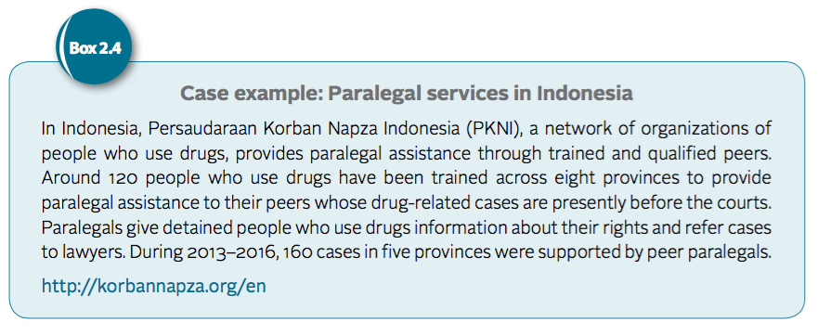
IDUIT Training Workshop / Day One / Session 5
Activity: Advancing Human Rights

Slide 44
IDUIT Training Workshop / Day One / Session 5
Activity: Documenting Human Rights Violations
The ‘6W’ guide for documenting human rights violations:
WHAT – What violation occurred? What was the accusation made, the law cited or the weapon used?
WHERE – The street, building or facility, and the address
WHEN – The time, day, date and year of the incident
WHO – Who was the direct victim? Who were the perpetrators? Are there witnesses or other people with direct knowledge of the violation (e.g. medical staff, police, outreach workers)?
WHY – Gather assessments or documentation from those most closely involved as to the circumstances, motivations, actions or words that led up to the violation
HOW – How did the violation occur, and how did the victim’s status as a person who uses drugs contribute to the violation?

Slide 45
IDUIT Training Workshop / Day One / Session 6
Activity: Reflections on the day
Advocacy priorities to be identified for further use during the policy dialogue on the third day of the seminar or for use in subsequent advocacy work

