Slide 1

Gender approach in testing and other harm reduction interventions
Sasha Gurinova
Olga Belyaeva

Slide 2
Content
Why should harm reduction services be focused on women who use drugs?
Most common problems of WUD and deficits of low threshold settings. Examples from HA-REACT project in Latvia and Hungary.
Proposals to improve existing services

Slide 3
Why should harm reduction services be focused at women who use drugs?
Notes:
The overall epidemiological picture of drug use shows gender disparities, with approximately 75-80% of drug users being males, and 20-25% being females. NGO’s, participated in the project in Hungary and Latvia reported similar numbers – from 3 to 20% of clients are women. This fact remain poorly explained and understood and needs further researches, because…

Slide 4
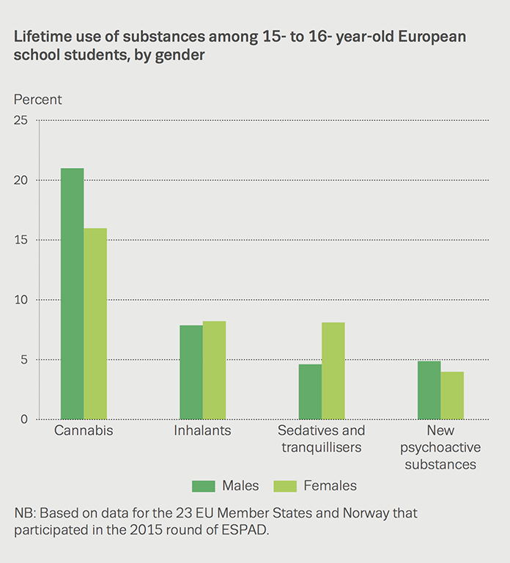
Why should harm reduction services be focused at women who use drugs?
Notes:
Generally, we lack data on drug use and gender, also in relation to HIV/HCV prevention and care. Avaliable data reflects mostly women sex workers, or partners of men injecting drugs.

Slide 5

Women who use drugs remain more vulnerable and at higher risk than their male counterparts. Compared to males who inject drugs, they experience:
Higher mortality rates
Faster progression to drug dependence
Increased likelihood of injecting related problems
Increased level of risky injecting and/or sexual behaviors
Increased rates of HIV
Notes:
Women and men who use drugs differ in various aspects, including social characteristics, consequences of substance use and development and progression to dependence;
and women present unique concerns that are sex and gender based. Despite these differences, many drug use interventions are male oriented

Slide 6

Most common problems of WUD and deficits of harm reduction services
Stigma
Stigma from individuals/society
Stigma from services/programmes
Systemic, structural or institutional stigma
Self-stigma
STIGMA
LACK OF GENDER SPECIFIC HR SERVICES
INCREASED RISKY DRUG USE/SEXUAL BEHAVIOUR
Notes:
Stigma from individuals/society The negative views and stereotypes held by individual members of society towards WUD. Stigma towards WUD is often greater than that experienced by men who use drugs. WUD are stigmatised as immoral, bad mothers/spouses, and a shame to the family for crossing gender norms. This stigma often follows women even after they stop using drugs.
Stigma from services/programmes Policies and practices that create barriers to service access, such as judgemental attitudes of service-providers, lack of confidentiality/privacy for the client or demanding women to be accompanied by a man to access services.
Systemic, structural or institutional stigma Punitive and harsh drug-control laws, and coercive and corrupt law enforcement practices and policies that officially restrict or prohibit
access to public services for people who inject or otherwise use drugs. A specific concern for women is the risk of losing custody of their children because of drug use.
Self-stigma The internalization of stigmatizing views and attitudes by WWUD.

Slide 7
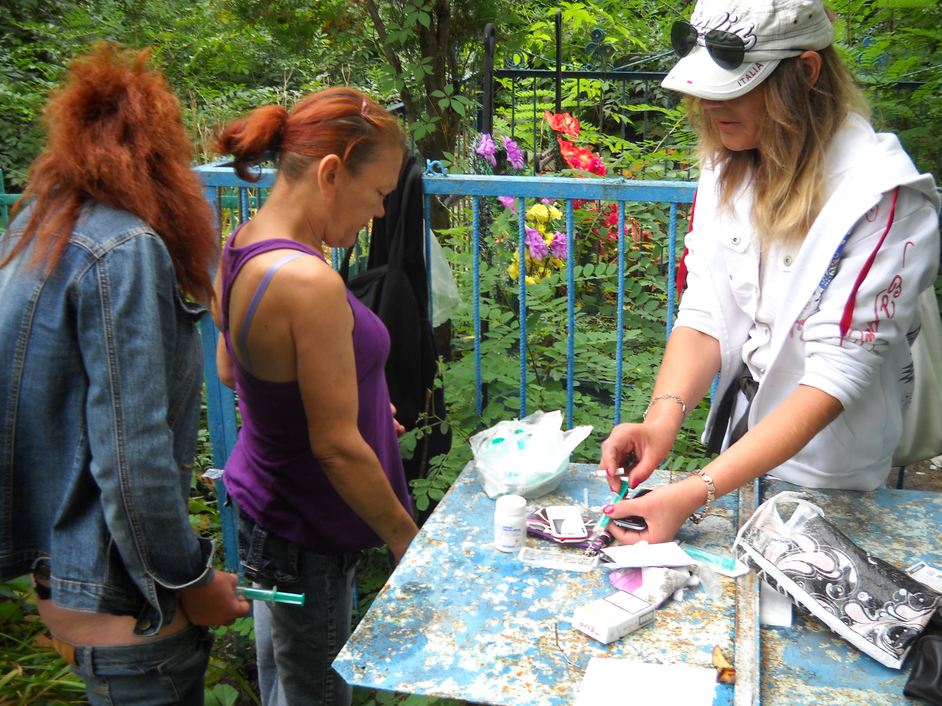
Most common problems of WUD and deficits of harm reduction services
We can safe ourselves from HIV and HCV
but we can’t prevent the leak of the private information about us,
so we chose the cemetery: the dead don’t talk
Notes:
The photo was taken 2 years ago. One of the women is in prison now, another passed away, with the third one we lost contact. Why don’t we use services? Because of the fear, based on our experience: the information I provide can be used against me.

Slide 8


Most common problems of WUD and deficits of harm reduction services
Rights violation
Deprivation from children
Sexual violence
Marginali-zation
Family rejection
Financial instability
Humali-ation
Sex work
Notes:
SOCIOCULTURAL VULNERABILITIES, are a consequence of drug use among women, further hinder their access to services and compound their health risks

Slide 9
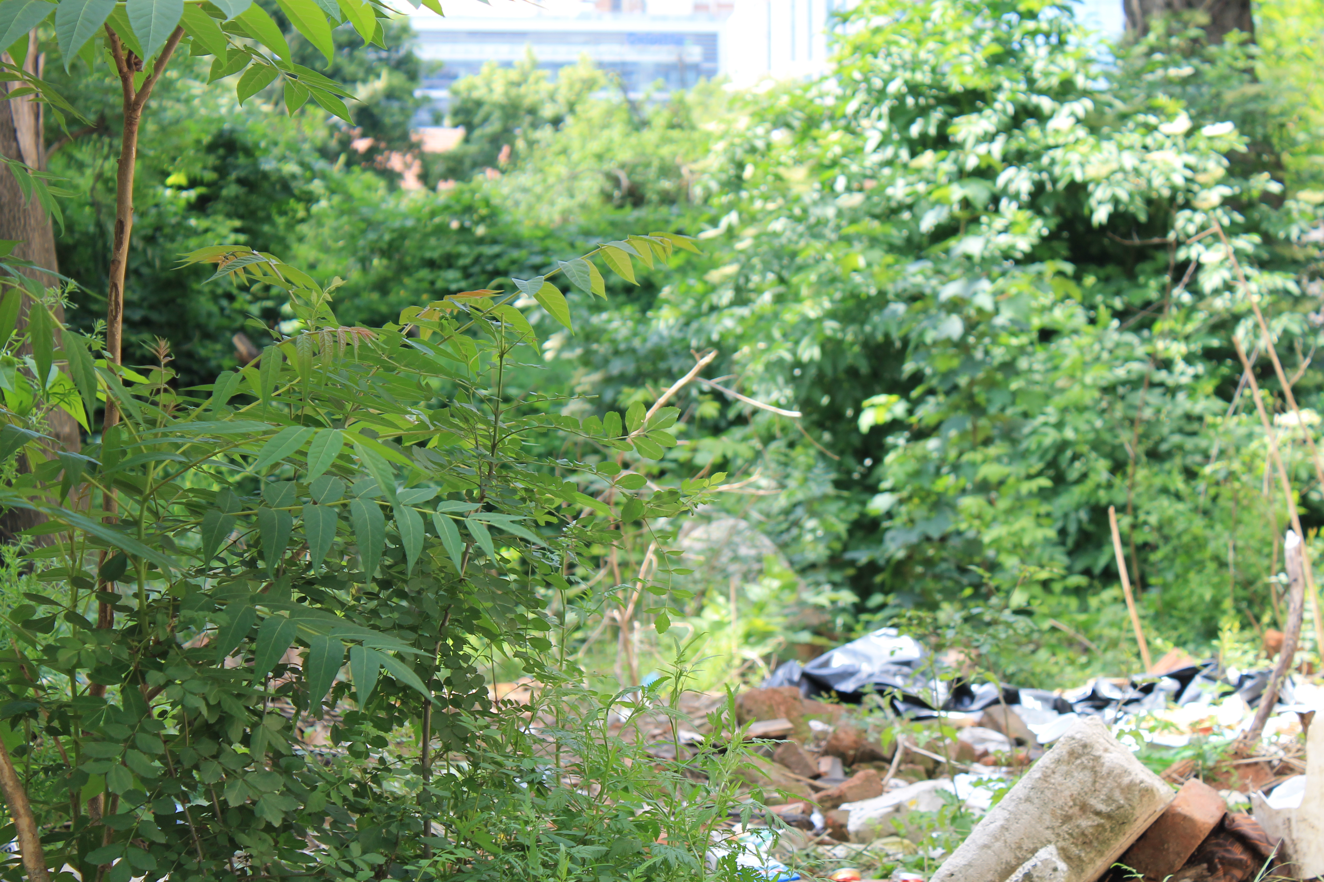
On the photo: a woman is injecting drugs.
Did we learn to be invisible?
Questionnaires before and after rapid tests are often too long (40 min) and aimed to collect all kind information, not necessarily useful. The questions are often not sensitive to our experience and our feelings. This leads to nervous breakdowns and overdoses, refusing to use services.
Notes:
Have you been raped? What STI do you have? Where do you take money for the drugs from? Why do you ask this question when I come with issues about methadone? Every answer keeps deep trauma and memories which we are trying to hide. And still, when we go out from such a “consultation” – we are in tears, we are desperate and frightened. So, the social workers know my secrets, and I am ashamed to look into there eyes. Time to be invisible again.

Slide 10
Most common problems of WUD and deficits of harm reduction services
Health Risks
Sexual and Reproductive health
Pregnancy (unwanted/planned)
Pregnancy complications
Physical health
Fatigue and physical weakness
Lack of appetite
Psychological health
Depression
Unsafe abortions
STI
Severe vein damage
Anxiety
Stress
Sleeping disorders
- Condom non use
- Contraceptive misuse
- Lack of self care
- Excessive use of sleeping pills
- Unsafe use/sexual behaviour
- Self-stigma
- Suicidal thoughts and attempts

Slide 11

In order to improve access of WHUD to harm reduction services it is essential to adopt those services for their needs.

Slide 12

Advocacy work (national level)
Advocacy work (national level)
Direct contact and involvement
Gender mainstreaming is standard practice
Stigma of WUD is reduced
Women’s access to healthcare and harm reduction services
There are health- and harm reduction services that fit
the needs of WUD.

Slide 13

Advocacy work (national level)
Estonia received UN recommendations on SC and community about parental, child protection, and labor rights
Good - community and state work together
NEED to change - A lot of critics against research outcomes
Negative reports about women who use drugs in media.
Notes:
No, I am not going to the methadone program anymore. The doctors got to know that I have 3 children and I already had social workers in my house. Obviously they will find a way to take my kids away. I need to hide. И это частая причина отказа женщин обращаться за помощью, где комплексный подход начинается с распространения всем службам информации. Что можно сделать? Прекратить пренебрежительно относиться к данным исследований, которые проводят гражданское общество. Ценить открытую позицию женщины. Как? в случае нападок СМИ стать рядом и своими статьями и блогами помочь сохранить честь и достоинство женщине, которую сама система поставила в условия изгоя и выживающей вопреки желанию системы нас елеменировать.

Slide 14

Improving existing services
2. Local level (improving existing services)
“Kids corner” and changing table for babies
Self-help groups for women (safe injection skills training)
Child rearing consultations
Consultations on sexuality
Motivate GPs to work with HR services
Involve peers/women
Work out referral strategies for women

Slide 15

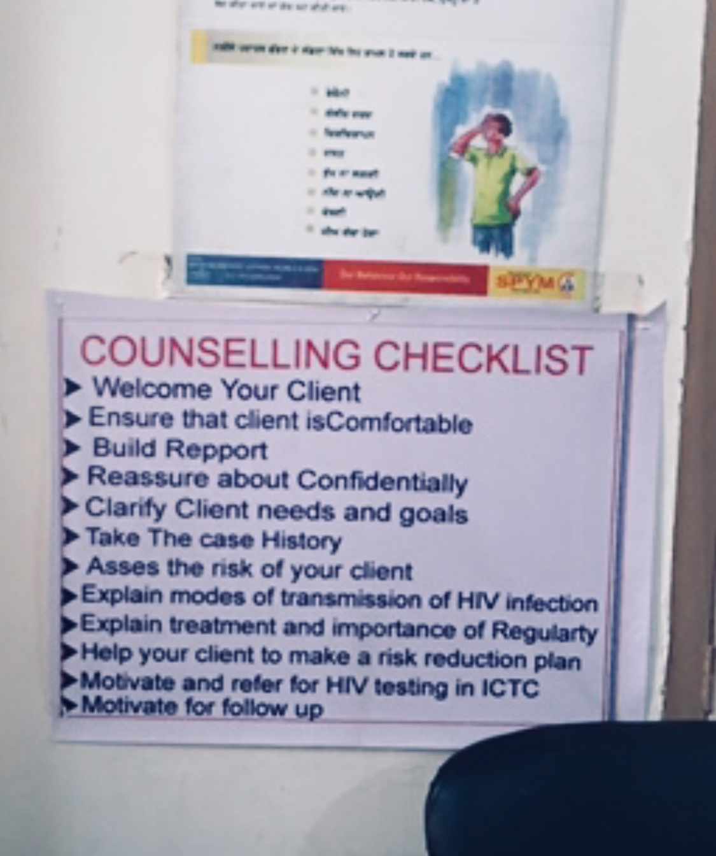
Trust begins with honesty:
Who are you?
What are you doing?
What do you do with my
personal data (we know it
anyway).
Which of my problems you
know how to solve.
Notes:
Living under repression formed great mistrust in us. Make first steps to us. Write openly about your services.

Slide 16


Notes:
There are number of projects implemented on the topic women and drug use, but it is still not essential. We finally need to look seriously at gender differences.

Slide 17

Freedom, happy, healthy and wealthy women who use drugs

