Slide 1

Positive developments and lessons learnt from national processes in CEECA countries
the thematic discussions in preparations for the ministerial segment of the 62nd session of the Commission of Narcotic Drugs (CND)
23 October 2018
Olga Belyaeva Eurasian Harm Reduction Association

Slide 2
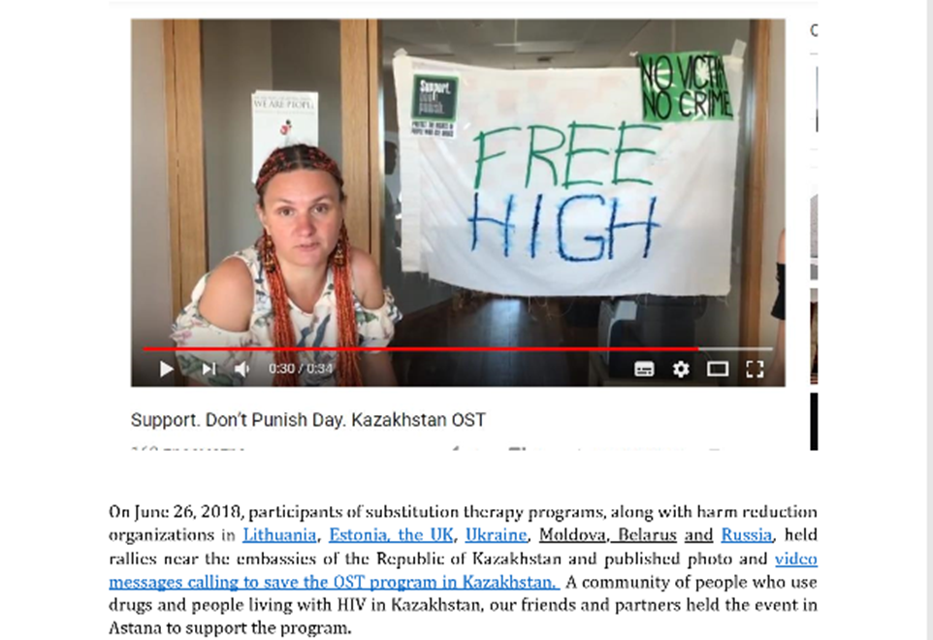
EHRA sets regional and national agenda and harm reduction with the meaningful involvement of community of people who use drugs

Slide 3
In EECA up to 50% of prisoners are people who use drugs
Distribution of new HIV cases among people who inject drugs

Slide 4


Positive developments on national level
Estonia. June 2018. New project SÜTIK with the main goal to socialize people living with addiction
Lithuania. October 2018.Parliament legitimated cannabis derived medicines (enters into power in May, 2019)
and researches with all substances
from the 1st list are allowed.

Slide 5


Positive developments on national level
Sakartvelo/Georgia There are 4 legislative bills in parliamentary pipeline now: Decrim Bill, Rights Law, Cannabis consumption regulation and Regulation of Cannabis cultivation and production for medical and industrial use.
Kyrgyzstan – 2019. New Codes of Misconduct and Crime with some positive aspects: it clears up the alternative to punishment in the form of rehabilitation; the implementation of probation.

Slide 6

Lesson learnt and feedback from people who use drugs (1)
Tbilisi’s #raveolution Sakartvelo/Georgia
Georgia: 01.10.2018 𝘗𝘰𝘭𝘪𝘤𝘦 𝘥𝘦𝘵𝘢𝘪𝘯𝘦𝘥 𝘢 𝘱𝘦𝘳𝘴𝘰𝘯 𝘸𝘪𝘵𝘩 𝘢 𝘴𝘺𝘳𝘪𝘯𝘨𝘦 𝘤𝘰𝘯𝘵𝘢𝘪𝘯𝘪𝘯𝘨 𝟎.𝟎𝟎𝟐 𝐠𝐫𝐚𝐦𝐬 𝘰𝘧 𝘯𝘢𝘳𝘤𝘰𝘵𝘪𝘤 𝘥𝘳𝘶𝘨𝘴 (𝘮𝘦𝘵𝘩). 𝘏𝘦 𝘧𝘢𝘤𝘦𝘴 6 𝒚𝒆𝒂𝒓𝒔 𝒊𝒏 𝒂 𝒋𝒂𝒊𝒍.
Decriminalization bill – stuck on first iteration with committees.
Cannabis consumption regulation, if accepted and made as a law, will come in contradiction with the last Constitutional court decision legalizing
Cannabis
consumption

Slide 7
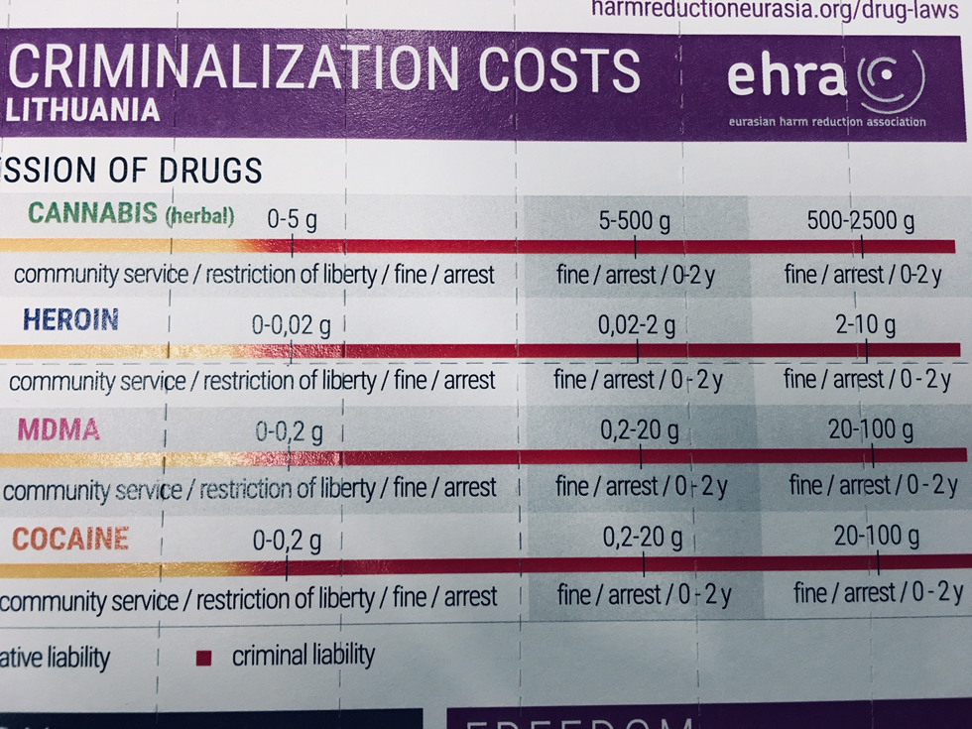
Lesson learnt and feedback from people who use drugs (2)
Lithuania
Kyrgyzstan
Re-criminalized all drugs since 2017
The same year up to 1400 people, age 18-29, got criminal record
2019 The penalty for possession of small amount is from 500 to 4000 Euro (average salary is 14 Euro per month).
If one can`t pay during three months, imprisonment up to 2.5 years
+ upon release a person must pay 50% of the fine
*2018 - only 2 out of 10
PWUD are able to pay fine
up to 400 Euro.

Slide 8


EECA community advocacy efforts
in Kazakhstan the community advocacy efforts are aimed on keeping and widening the OST program;
in Belarus the community advocacy efforts are aimed on getting take-home OST pills to keep socialization going.

Slide 9
OST Coverage in EECA by country
In order to reverse the HIV epidemic, the % of PWID involved in NSP services should be 60% of all people with opioid dependence, and the number of people receiving OST treatment should reach 40%. (WHO technical guide, UNAIDS, 2012)

Slide 10
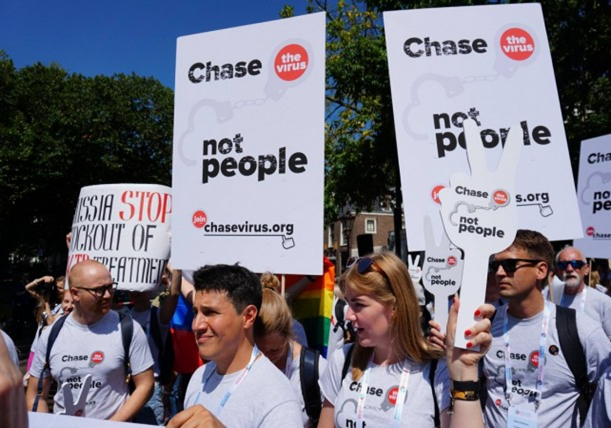
Any conventions can't abolish countries’ obligations to protect the rights of citizens to get the highest attainable level of health and well-being

